Slide 1
Access Horizon ADW through REST API
Gagan Vamsi Reddy
Manager: Ramakrishna Tumrukoti
Mentor: Manikya Rohith Reddy Gangavaram

Slide 2
Contents
1
Overview
2
Tech stack and Tools
3
Deep dive
4
References

Slide 3
Overview
Currently, since the data ingested from different services are sensitive in nature, the ADW sits behind a private endpoint and cannot be accessed directly outside the private endpoint gateway network. We are planning to expose some ADW objects(required as necessary) through Rest API's for various scenarios. One of the scenarios relevant to the project is to run a job as part of a pipeline running on Airflow via a call to rest API. There are two approaches and the goal of the project is to evaluate both the scenarios and compare them in various aspects.
Path-1:- ADW itself has a way to expose the database objects via rest API as part of its service.
Path-2:- We can host compute instances running tomcat server and handle the Rest API calls and connect to DB and act accordingly.

Slide 4
Tech stack and Tools
Apache JMeter for Load Testing ,Postman for testing API’s.
Python for data visualization.
Java for processing API’s inside TC server
Docker for containerization, OCI-CLI for creating architecture in cloud.
Apache Airflow for scheduling and monitoring workflow

Slide 5
Deep dive
1. Path-1
1.1. Progress
1.2. Graphical Analysis
2. Path-2
2.1. Progress on Server
2.2. Graphical Analysis
2.3. Architecture For Path-2
2.4. Apache Airflow
2.4.1. Introduction
2.4.2. Example
3. Comparing both Approaches

Slide 6
Path-1

Slide 7
1.1. Progress
To connect to ADW behind private endpoint we need to use NAT Gateway
To access database objects through REST APIs we can create dedicated modules or use AUTOREST feature
Performed load testing on the ADW for the AUTOREST service using JMETER.
Created graphical analysis reports for different configurations of ADW with different OCPU count.(with and without AutoScaling)
Github Link for the Data and Analysis

Slide 8
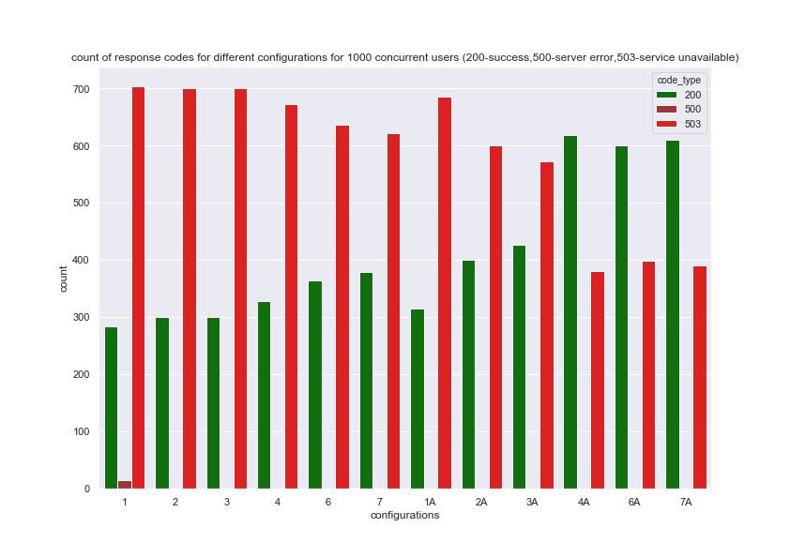
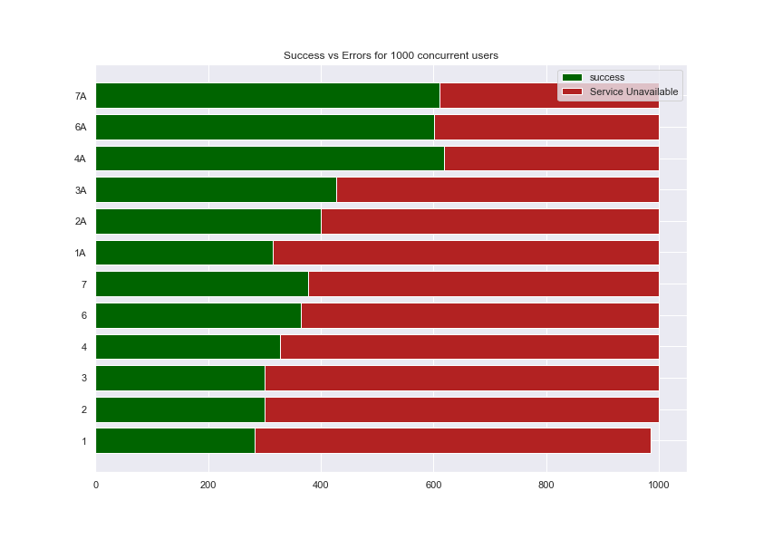
1.2. Graphical Analysis

Slide 9
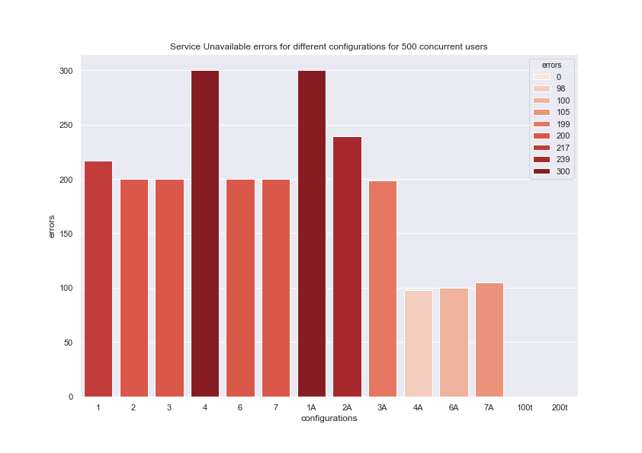
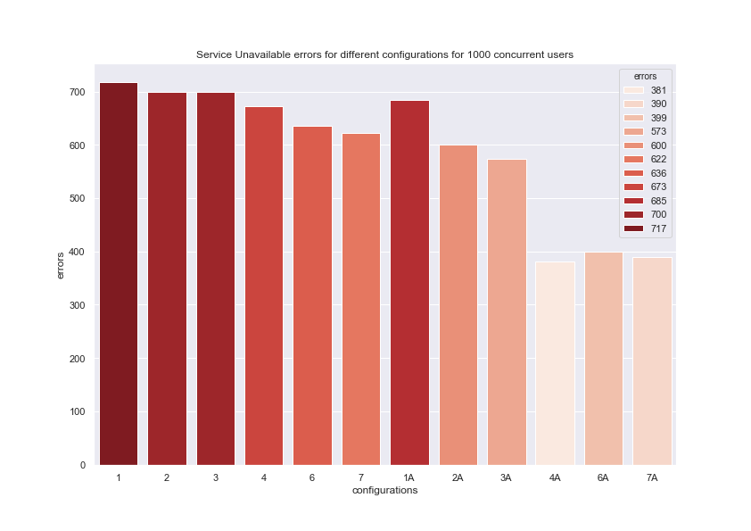
1.2. Graphical Analysis

Slide 10
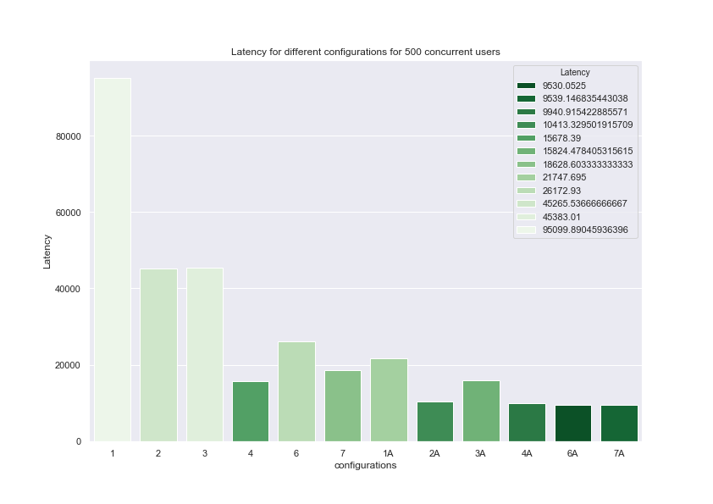
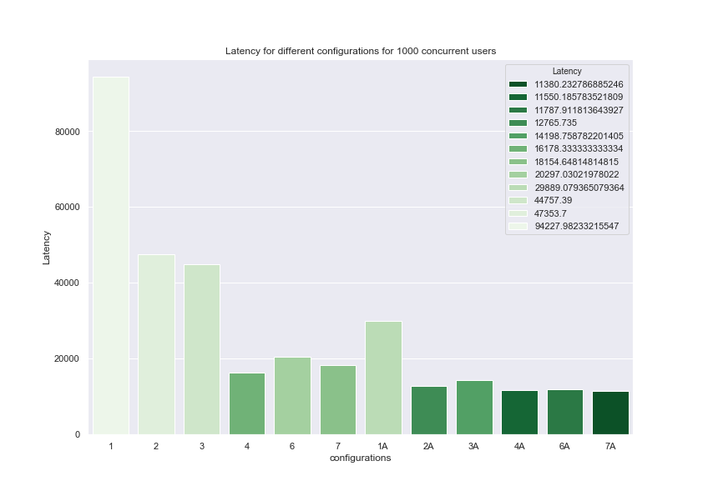
1.2. Graphical Analysis

Slide 11
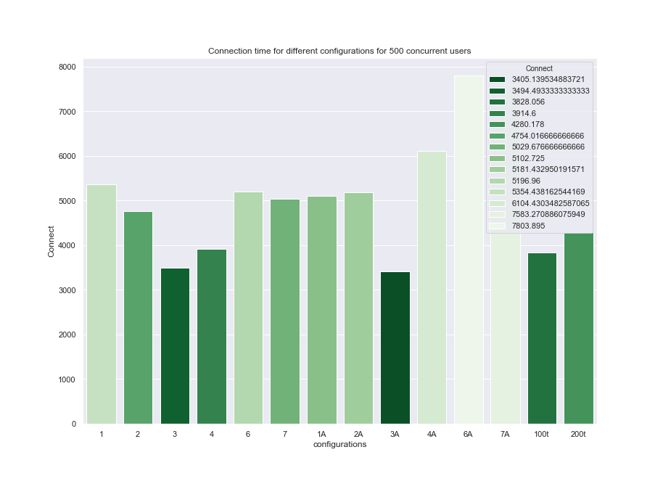
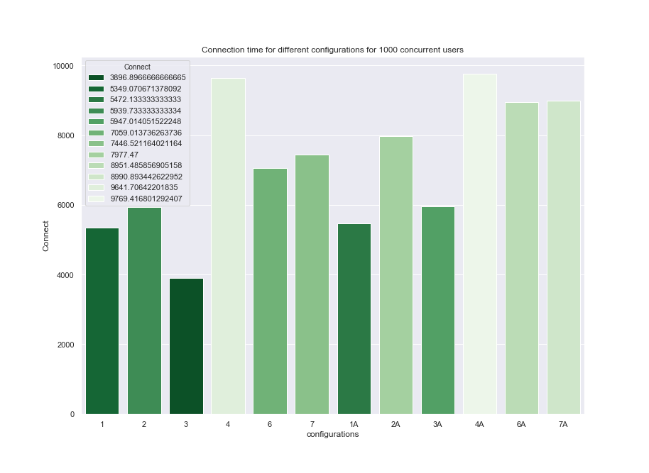
1.2. Graphical Analysis

Slide 12
Path-2

Slide 13
2.1. Progress on Server
Coded the API handler which accepts the requests according to the format mentioned below.
Example cURL Command Request: curl -i -X POST --user ORDSTEST:ordstest --data-binary "select sysdate from dual" -H "Content-Type: application/sql" -k <https://localhost:8088/ords/ordstest/_/sql>
reference:- https://docs.oracle.com/en/database/oracle/oracle-rest-data-services/18.2/aelig/rest-enabled-sql-service.html#GUID-E44BF01E-7F11-44B4-B9AF-2755267D9D62.
The endpoint will accept the details of the user and password in the basic authentication format that is encoded in BASE64 which we will extracted and decoded in the Servlet.
The server uses Wallet details to connect to database then user details to login as user.

Slide 14
2.1. Progress on Server
Path | Method | Request Payload | Response | Request Header | Operation
/ords/<db_name>/_/sql | POST | <SQL Query> | Result of SQL query |  | Connects to the Database ,Executes the sql query and returns the response in Json format
/ords/<db_name>/_/plsql | POST |  | Successful (if query the procedure is executed successfully) | procedure* (procedure name) paramscount* (no of parameters) i (ith parameter value) i_type (ith parameter type) | Calls the named procedures with the parameters specified in the Headers
/ords/<db_name>/_/job | POST |  | Successful (if the job is created successfully) | job_name* job_type* job_action* comments* | Creates a job and triggers it using the Job_scheduler
/ords/<db_name>/_/job/<job_name> | GET |  | Details about the job Status |  | Retrieves the job status and errors too (if failed).
/ords/<db_name>/_/job_running/<job_name> | GET |  | Details of the running job |  | Retrieves the running job status

Slide 15
2.1. Progress on Server
Wrote a Dockerfile that moves all the required files into Tomcat server image, compiles the required files and starts the server on port 8080.
Provided the support for Docker image to run in both arm64 and x86_64 architectures.
By hosting an Instance running this Docker Container performed Load testing using Jmeter for 2 configurations (100t→threadcount=100,200t→threadcount=200)
Github Link for the Tomcat Server and Dockerfile.

Slide 16
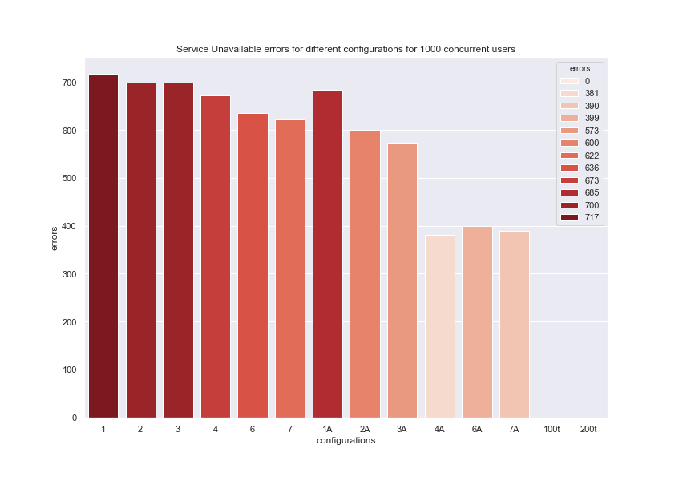
2.2. Graphical Analysis

Slide 17
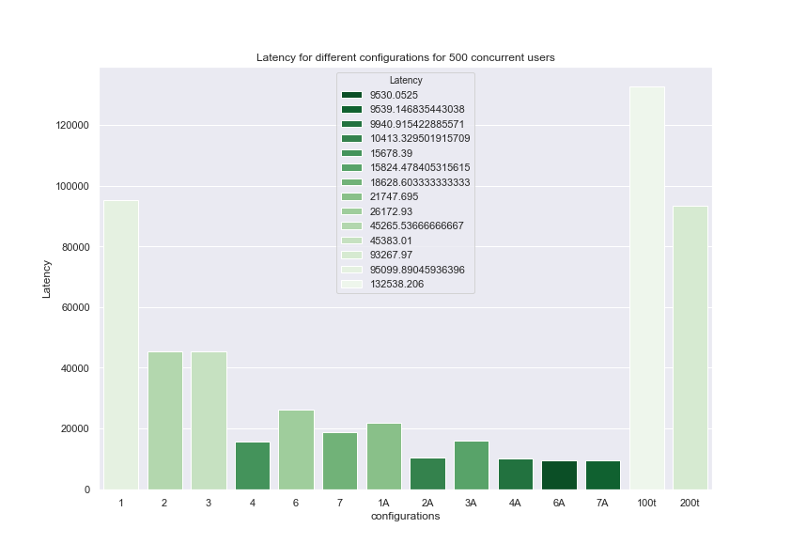
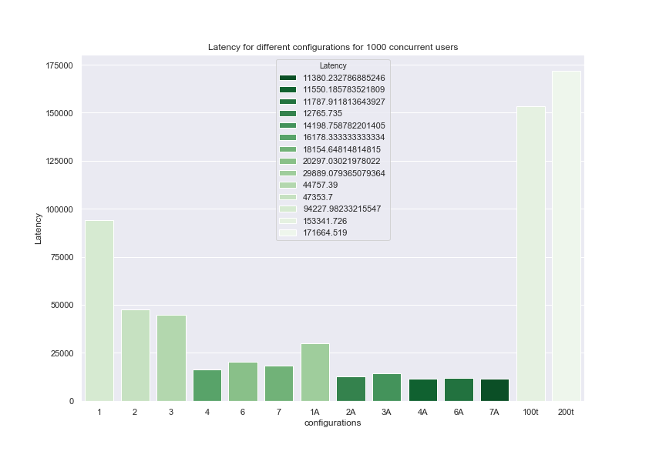
2.2. Graphical Analysis

Slide 18
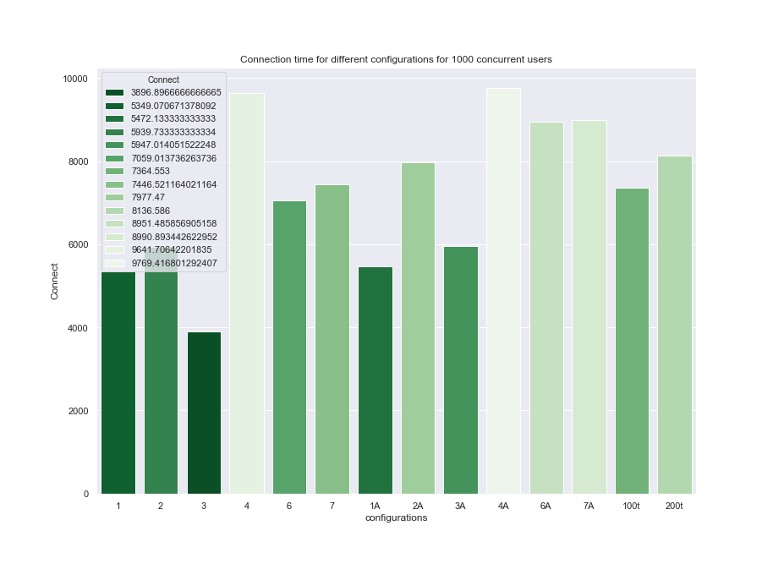
2.2. Graphical Analysis

Slide 19
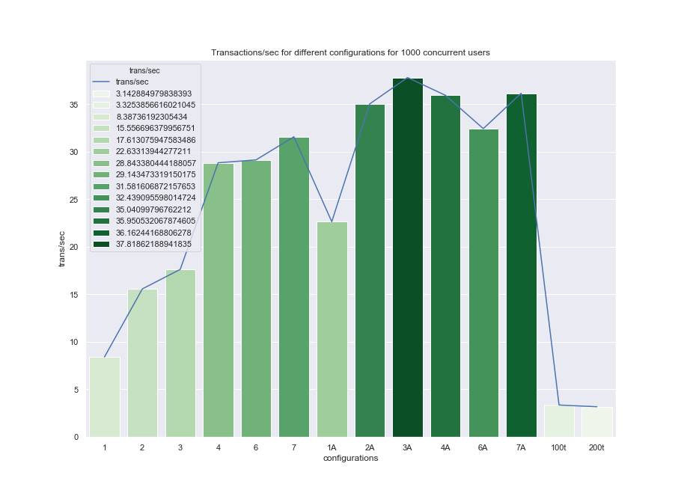
2.2. Graphical Analysis

Slide 20
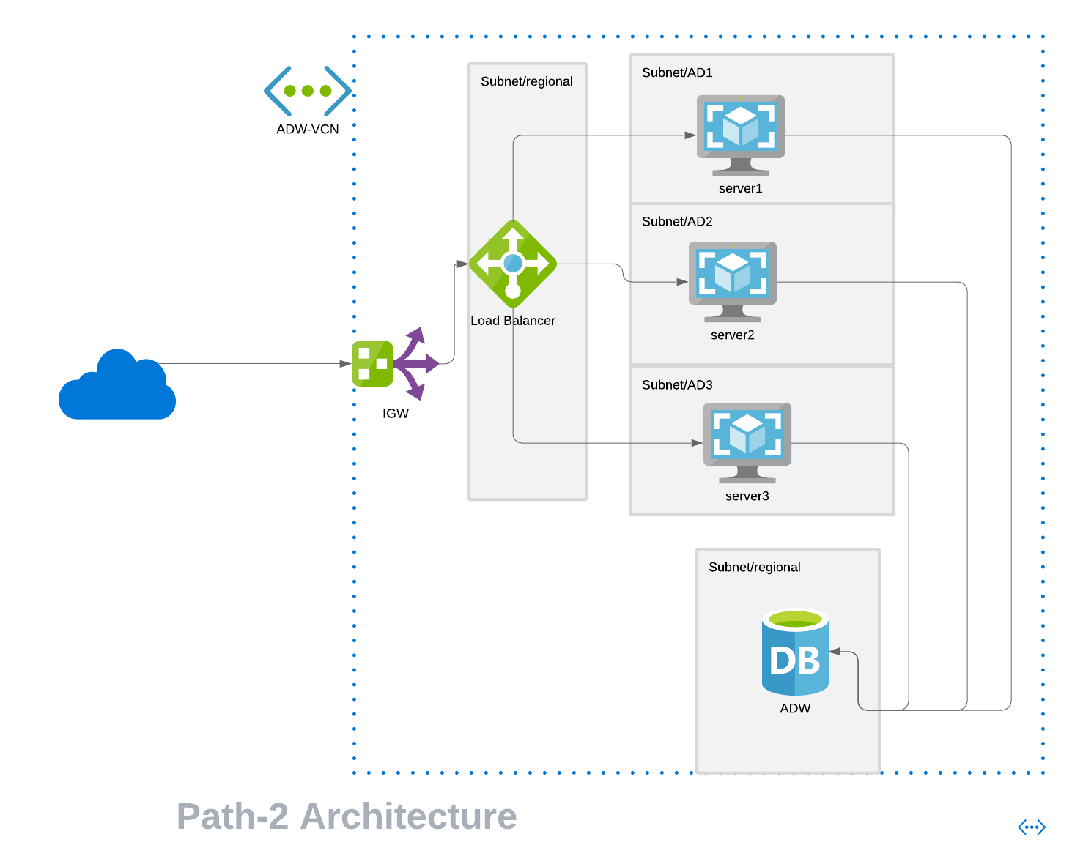
2.3. Architecture For Path-2

Slide 21
2.3. Architecture For Path-2
Wrote a script that will do the following things using the OCI-CLI (because of the free tier restrictions, could only create a single instance).
Creates a Subnet.
Creates an IGW
Adds the IGW to the Route table
Adds the rules to Security List to allow Port 22 and 8080
creates a Compute instance inside it.
Connects through ssh and installs the relevant packages, pulls the docker image from the docker hub, starts the container, and extracts the private IP of the instance.
Creates a Load-Balancer.
Creates Backend-set for the Load-Balancer.
Adds the above-created instance as Backend for the Load-Balancer.
Creates a Listener for the Load-Balancer.
Outputs the Public-IP of the Load-Balancer(to which we should send the requests).

Slide 22
2.4. Apache Airflow
Airflow is an open-source platform for programmatically authoring, scheduling, and managing workflows.
When workflows are defined as code, they become more maintainable, versionable, testable, and collaborative.
The rich user interface makes it easy to visualize pipelines running in production, monitor progress, and troubleshoot issues when needed.
In Airflow, workflows are defined as Directed Acyclic Graph (DAG) of tasks.
An operator represents a single, ideally idempotent, task. Operators determine what actually executes when your DAG runs.
Airflow provides a wide range of Operators (https://airflow.apache.org/docs/apache-airflow/stable/_api/airflow/operators/index.html).

Slide 23
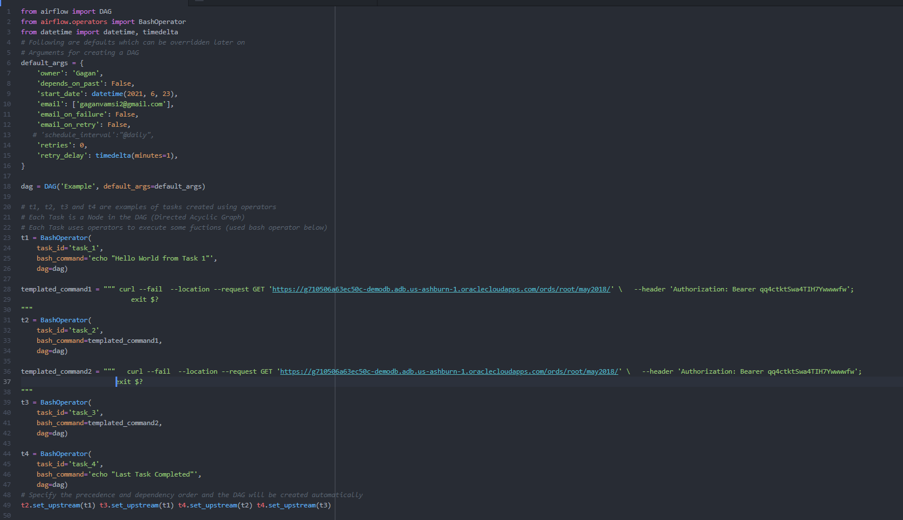
2.4.2. Example

Slide 24
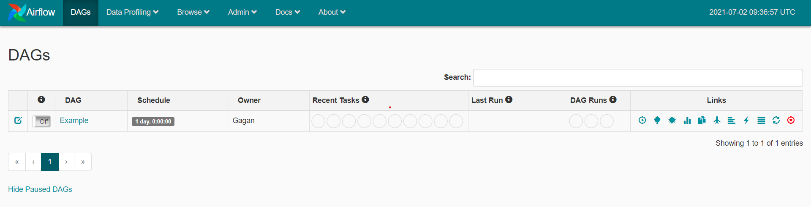
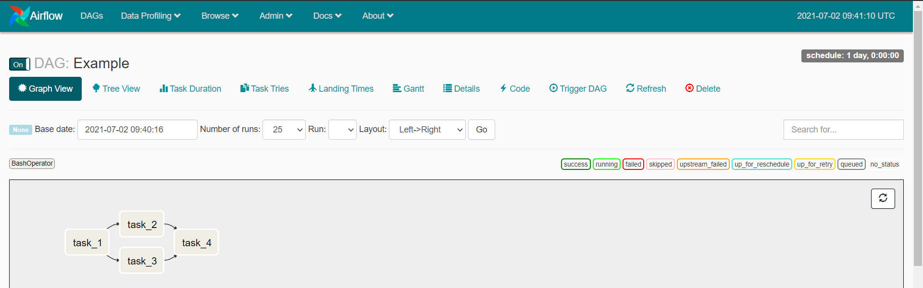
2.4.2. Example

Slide 25
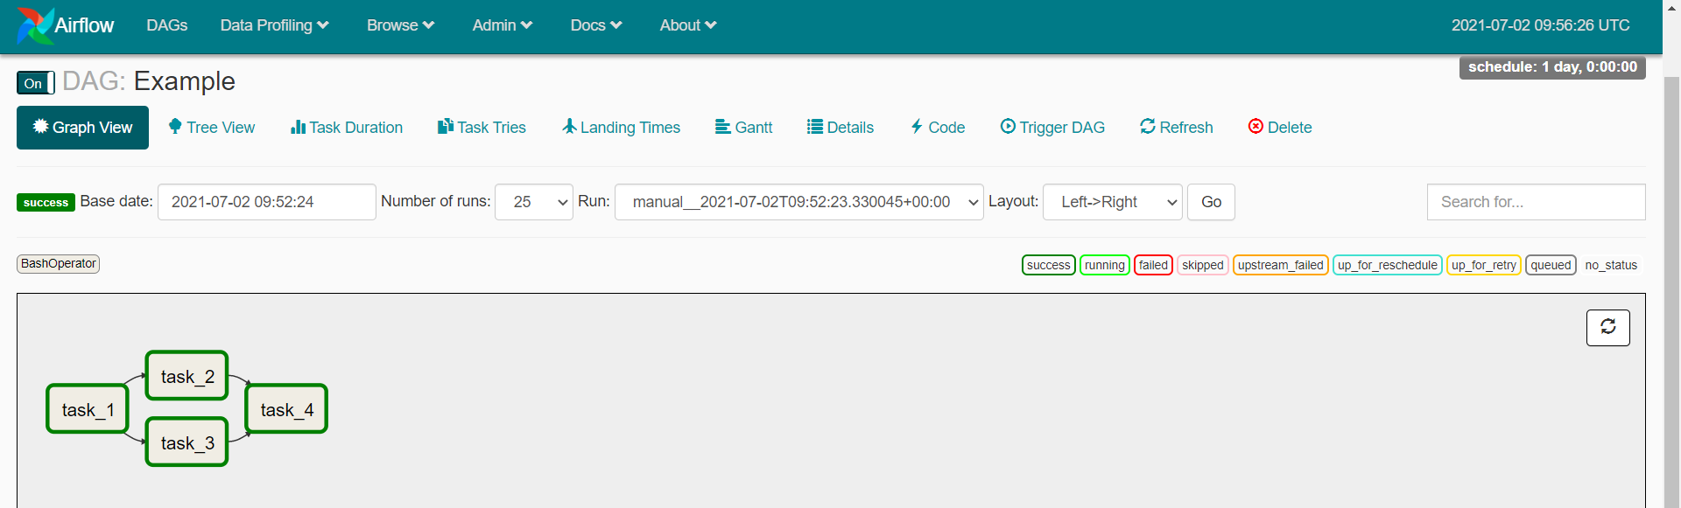
2.4.2. Example

Slide 26
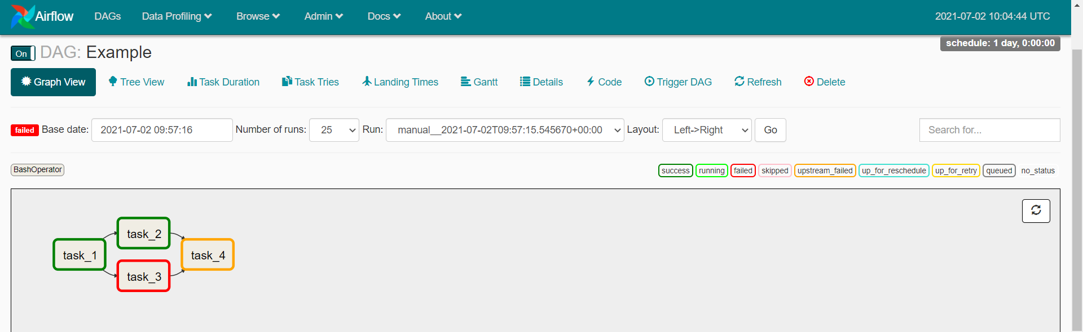
2.4.2. Example

Slide 27
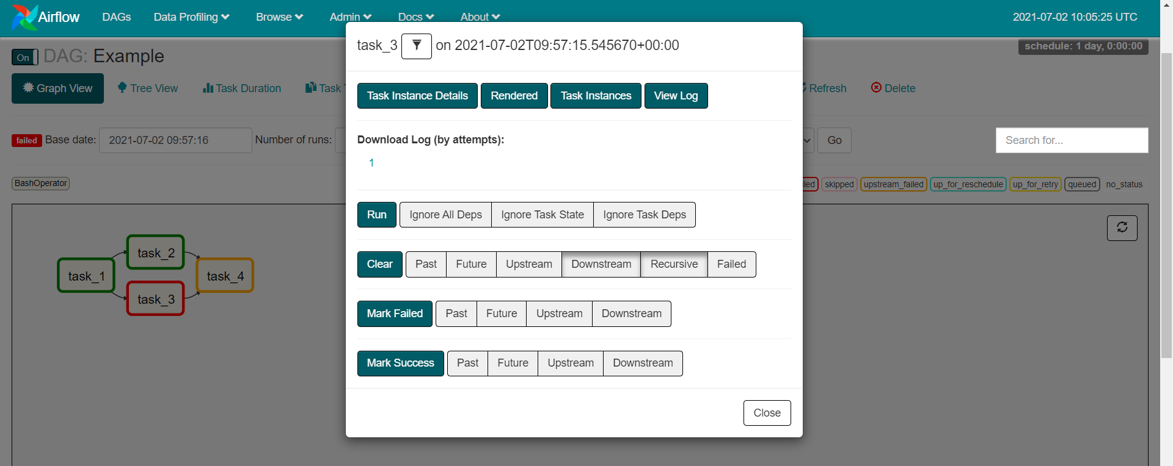
2.4.2. Example

Slide 28
3. Comparing both Approaches
3.1.1. Comparing features
3.1.2. The complexity of hosting

Slide 29
3.1.3. Failure points and recovery capabilities
Token Failure:-
We use Bearer token provided by the Oauth client to access the ADW objects through approach-1
Each token will be valid for only 1hr because of security reasons so if unauthorized error is occurred then we have to generate new token and then retry the same request to avoid this error.
Server Failure:-
If a server in the backend set of the Load Balancer fails the health checker will remove it from the backend and the rest of the servers will take the requests.
Even then if the request is failed then we can check the logs from Load Balancer or Airflow and can reconfigure the server.

Slide 30
3.1.4. Scalability
5.1.1. scalability of both approaches

Slide 31
3.1.5. Potential ways to rate-limit the number of transactions per second
By changing the Configurations of the TC server we can limit the value
Threadcount: Maximum number of concurrent requests processed
acceptCount: Maximum number of requests allowed in the queue

Slide 32
Questions?

Slide 33
References
https://docs.oracle.com/en-us/iaas/tools/oci-cli/2.25.2/oci_cli_docs/
https://medium.com/@calvinqc/build-a-simple-rest-apis-with-java-8-tomcat-jsp-mysql-intellij-on-mac-3308f4e59a03
https://docs.oracle.com/en/cloud/paas/autonomous-data-warehouse-cloud/rest-apis.html
https://docs.oracle.com/en/cloud/paas/autonomous-data-warehouse-cloud/tutorials.html
https://docs.docker.com/get-started/
https://blogs.oracle.com/cloud-infrastructure/getting-up-to-speed-on-using-private-endpoints-for-autonomous-database-with-shared-exadata-infrastructure
https://github.com/oracle/oci-cli
https://otube.oracle.com/media/OCI%20CLI%20Basics/0_hhuouae9
https://docs.oracle.com/cd/E17952_01/connector-j-5.1-en/connector-j-usagenotes-statements-callable.html
https://airflow.apache.org/docs/apache-airflow/2.0.1/
https://jmeter.apache.org/usermanual/index.html

Slide 34
Thank You!!!
Detailed Report Link
Github Link

